Slide 1
Friend function, static function and Assignment and Copy Initialization
01 july 2021

Slide 2
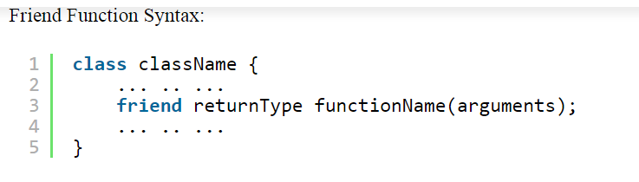
Friend Functions: Breaching the Walls
you want a function to operate on objects of two different classes
The function will take objects of the two classes as arguments, and operate on their private data

Slide 3
Characteristics of Friend Function in C++
The function is not in the ‘scope’ of the class to which it has been declared a friend.
It cannot be invoked using the object as it is not in the scope of that class.
We can invoke it like any normal function of the class.
Friend functions have objects as arguments.
It cannot access the member names directly and has to use dot membership operator and use an object name with the member name.
We can declare it either in the ‘public’ or the ‘private’ part.

Slide 4
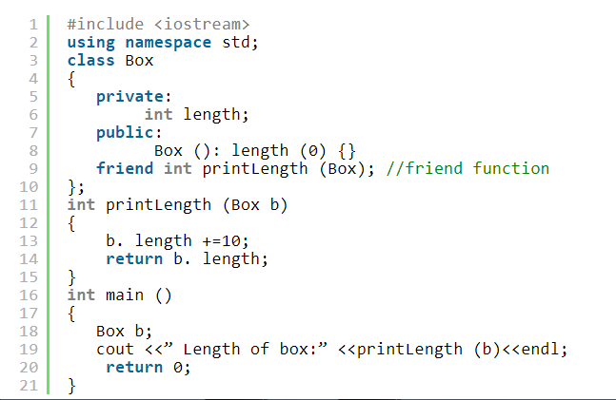
Friend function in public section

Slide 5
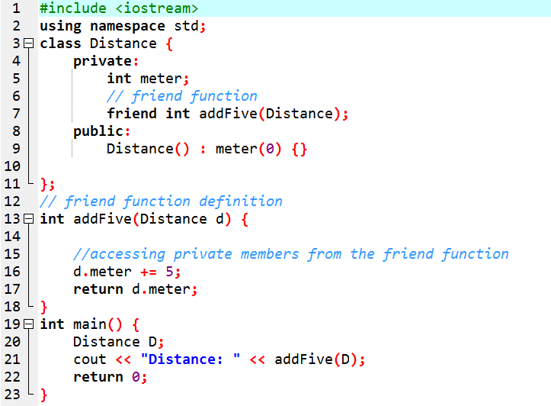
Friend function in private section

Slide 6
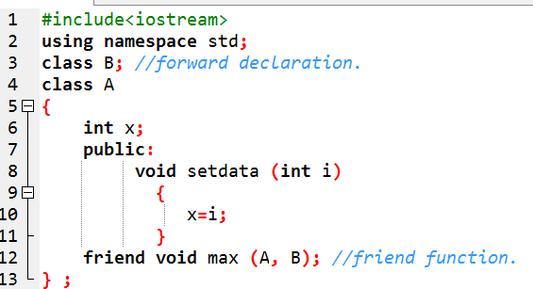
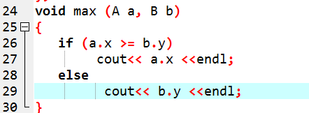
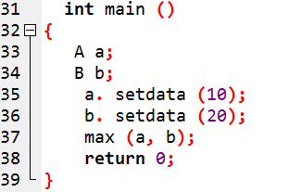
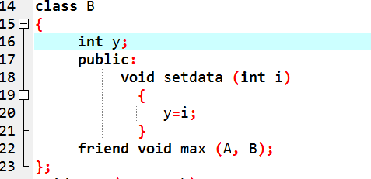

Slide 7
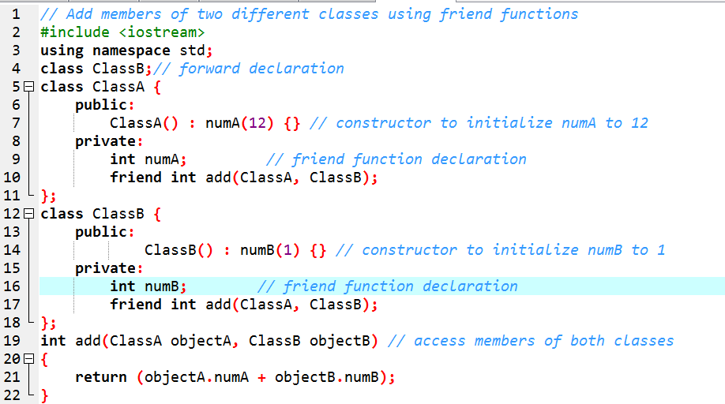
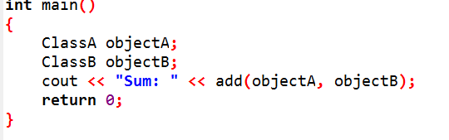
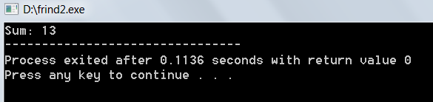

Slide 8
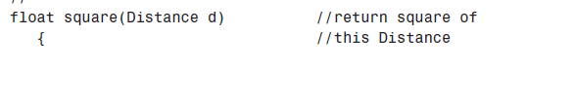
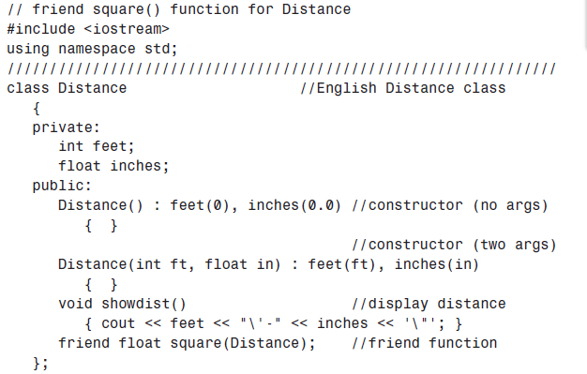

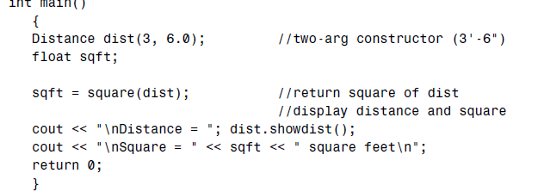
friend square() function for Distance

Slide 9
Static data member
Not duplicated for each object
Single data item is shared by all objects of a class.
It keep track of how many objects of itself there were.
Only one copy of that member is created for the entire class
shared by all the objects of that class , no matter how many objects are created

Slide 10
